Slide 1

Data Wrangling with R
DAiR Workshop 2024
July 11, 2024
Vandana Srivastava
PhD Candidate, Department of Computer Science and Engineering
Laboratory of Integrative Neuroscience Analysis

Slide 2
Agenda
What is data wrangling?
Data wrangling using “tidyverse”
How to read different data formats (.csv, .tsv, .xlsx ……)?
Data reshaping (pivot_wide, pivot_long)
Data organization (unite and separate)
Data exploration, manipulation, and cleaning
Accessing columns
Subsetting data
Handling missing values
Using ‘apply’ functions
Grouping data by columns
String replacing
More……..

Slide 3
What is Data Wrangling?
https://hprovax.github.io/DAiR2024.github.io/#data-wrangling

Slide 4

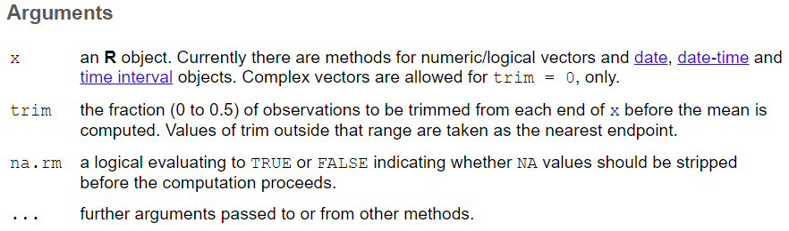
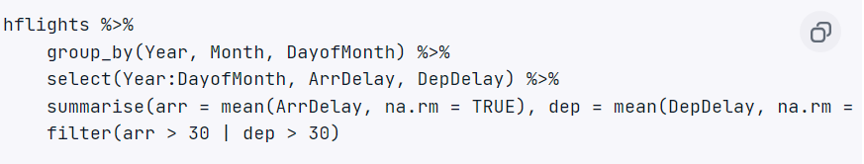
Packages and functions
tidyverse is a collection of R packages designed for data science
Installation
Example: install.packages(tidyverse)
Load package
library(tidyverse)
Functions:
Details:
?mean (to calculate arithmetic mean)
mean(x, trim = 0, na.rm = FALSE, ...)
R pipelines (% > %)
Way of chaining multiple operations together
Represented by %>% operator
Output of the expression on it LEFT and passes it as the first argument to the function on the RIGHT
https://www.tidyverse.org/

Slide 5
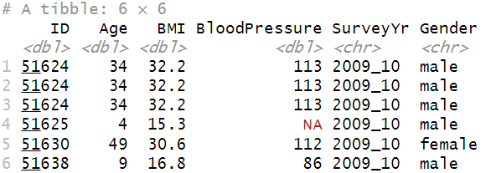
Reading the data – using readr from tidyverse
readr is part of the core tidyverse which can be loaded with library(tidyverse) OR
# Alternatively, install just readr:
install.packages("readr")
library(‘readr’)
readr supports the following file formats with these read_*() functions: (OR read.*())
read_csv(): comma-separated values (CSV)
read_tsv(): tab-separated values (TSV)
read_csv2(): semicolon-separated values with , as decimal
read_delim(): delimited files (CSV and TSV are special cases)
read_fwf(): fixed-width files
read_table(): whitespace-separated files
read_log(): web log files
Column specification
how each column should be converted from a character vector to a specific data type (e.g. character, numeric, datetime, etc.).
No column specification → readr will guess column types from the data
Column type guessing is very handy, especially during data exploration
Best strategy is to check and provide explicit column types if needed
# To find the guessed column specifications by readr
spec(data_obj)
Row
https://tidyr.tidyverse.org/ AND https://readr.tidyverse.org/
Column

Slide 6
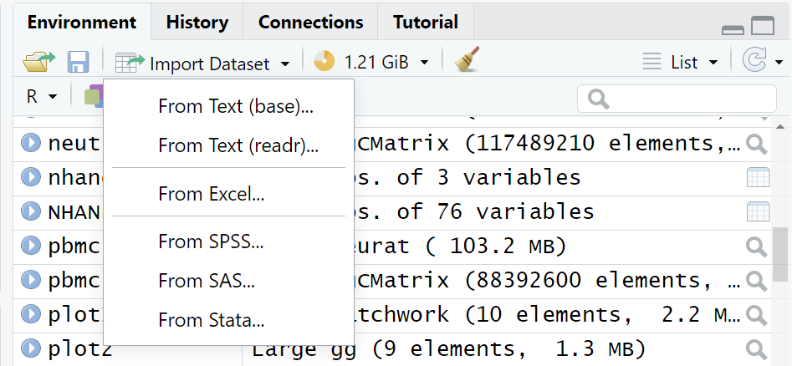
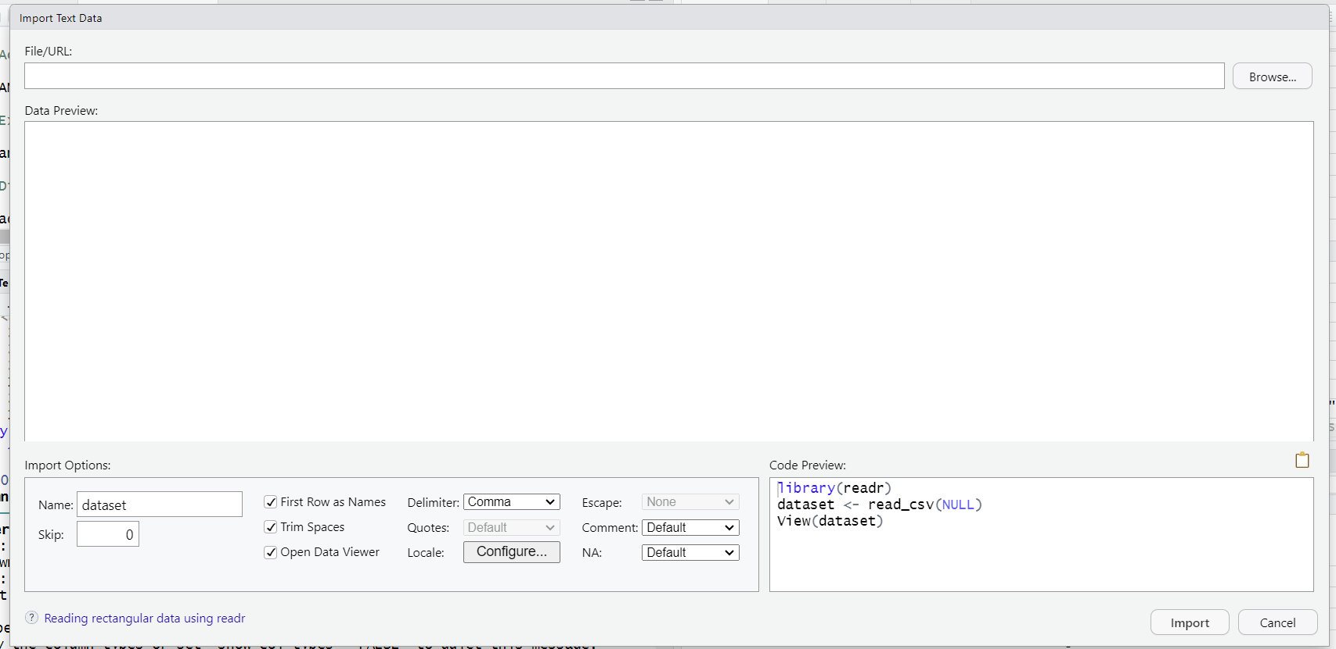
Reading the data – using Import Dataset in Environment pane

Slide 7
Reshaping the data
Shape of our data is determined by how values are organized across rows and columns.
Reshaping data:
wide to long format or vice versa
Should know the difference between observations and variables
Potentially resolve cases in which a single variable is spread across multiple columns or a single observation is spread across multiple rows
In general:
Wide data: a single metric spread across multiple columns ; often, but not always, takes on a matrix like appearance
Long data: each variable tends to have its own column
pivot_wider() converts long format data to wide
pivot_longer() converts wide format data to long
Long VS Wide data
These definitions depend on what is being ultimately considered a variable and what an observation.
https://bioinformatics.ccr.cancer.gov/docs/data-wrangle-with-r/pdf/combined.pdf

Slide 8
Organizing the data – Unite and Separate
separate - used to split columns
unite – used to combine columns
Example:
A column value has 2 types of information combined (e.g. an Ensembl id and a gene abbreviation, joined by “_”)
Feature
ENSG00000000003_TSPAN61
ENSG00000000003_TSPAN62
ENSG00000000003_TSPAN63
data1 <- separate(data, Feature, into = c("Ensembl_ID", "gene_abb"),
sep = “_", remove=TRUE)
data2 <- unite(data1, "Feature", c(Ensembl_ID,gene_abb),
sep="_")
https://bioinformatics.ccr.cancer.gov/docs/data-wrangle-with-r/pdf/combined.pdf

Slide 9
Manipulating and cleaning the data
Duplicates
Finding and removing
Handling missing values (NA)
Checking if there are missing values? is.na(data)
Imputing (replacing NA by column mean or 0 or something else)
Deleting NA rows
Correcting data type of the columns
Replacing incorrect strings / renaming column names and values

